Slide 1
Introduction to Java Programming:
Inheritance and Polymorphism in Java
Arafat Hassan

Slide 2
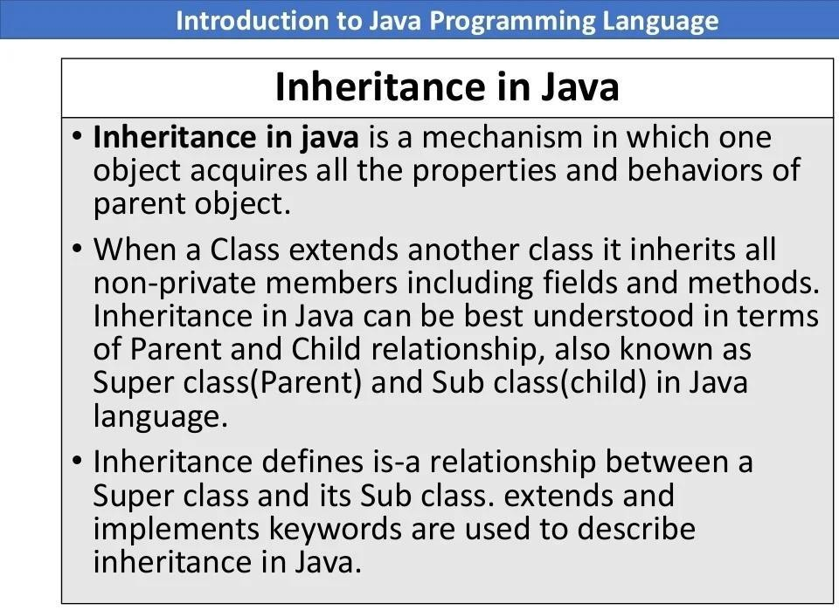

Slide 3
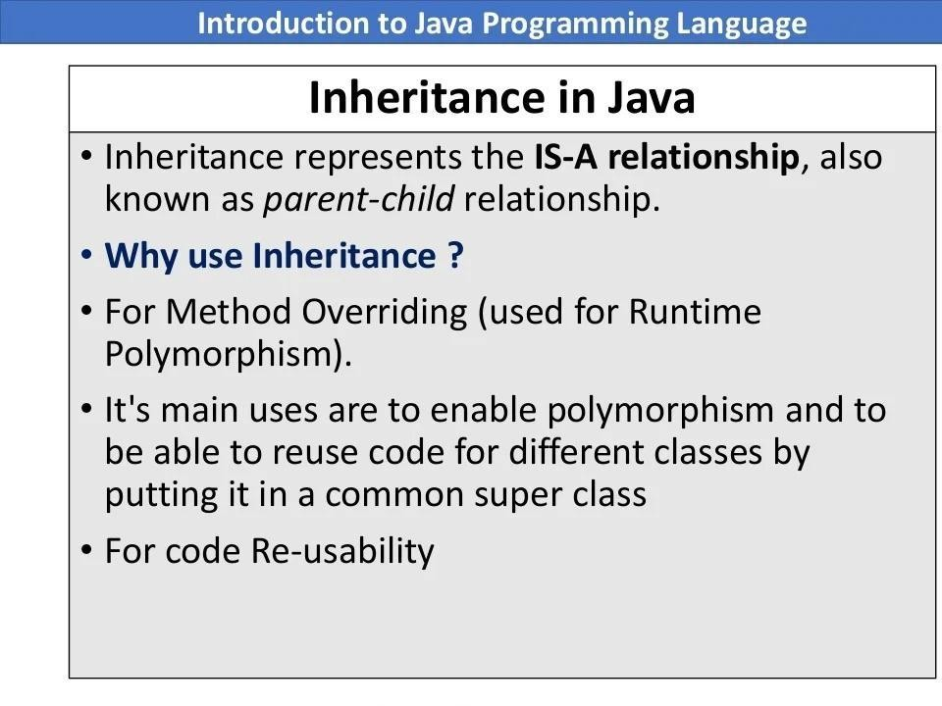

Slide 4
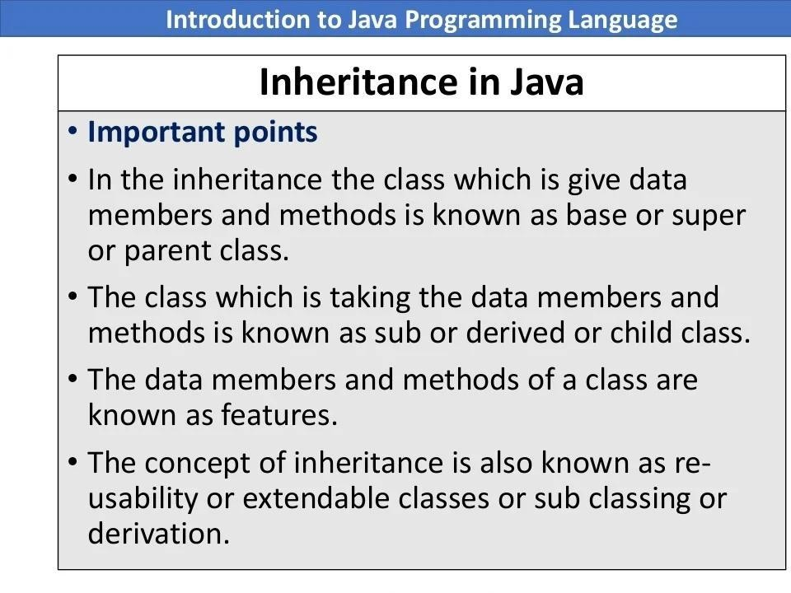

Slide 5
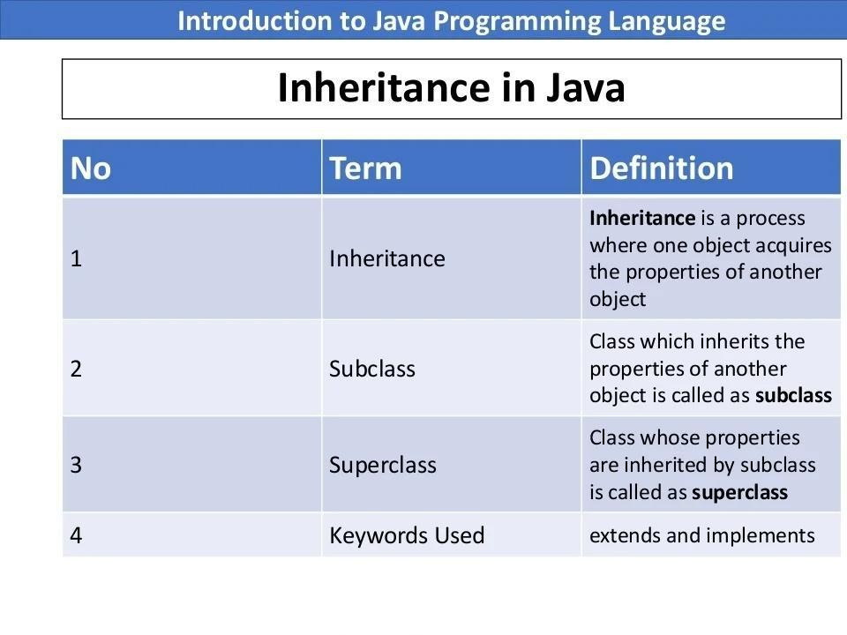

Slide 6
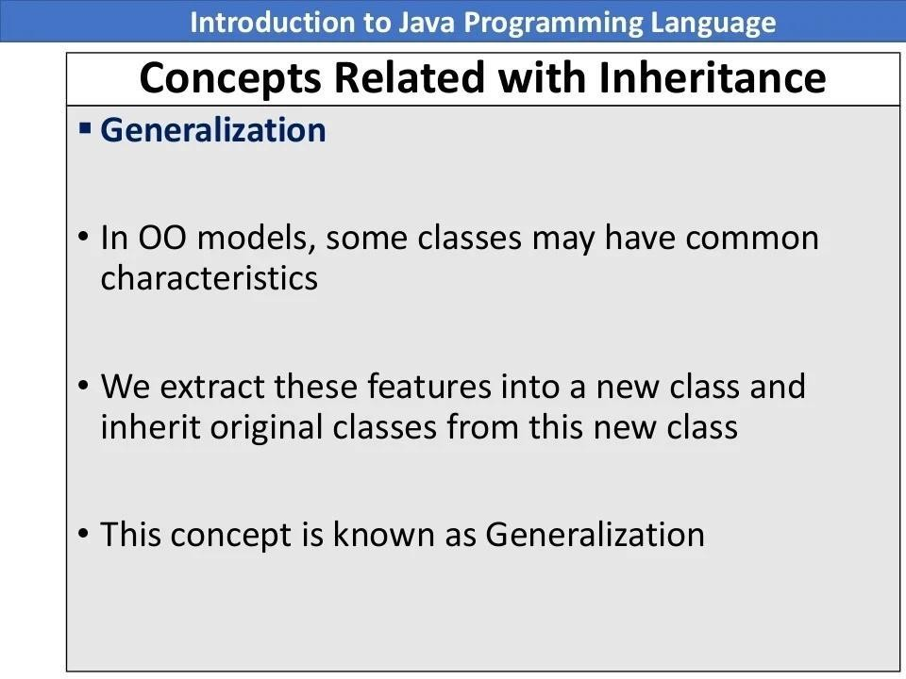

Slide 7
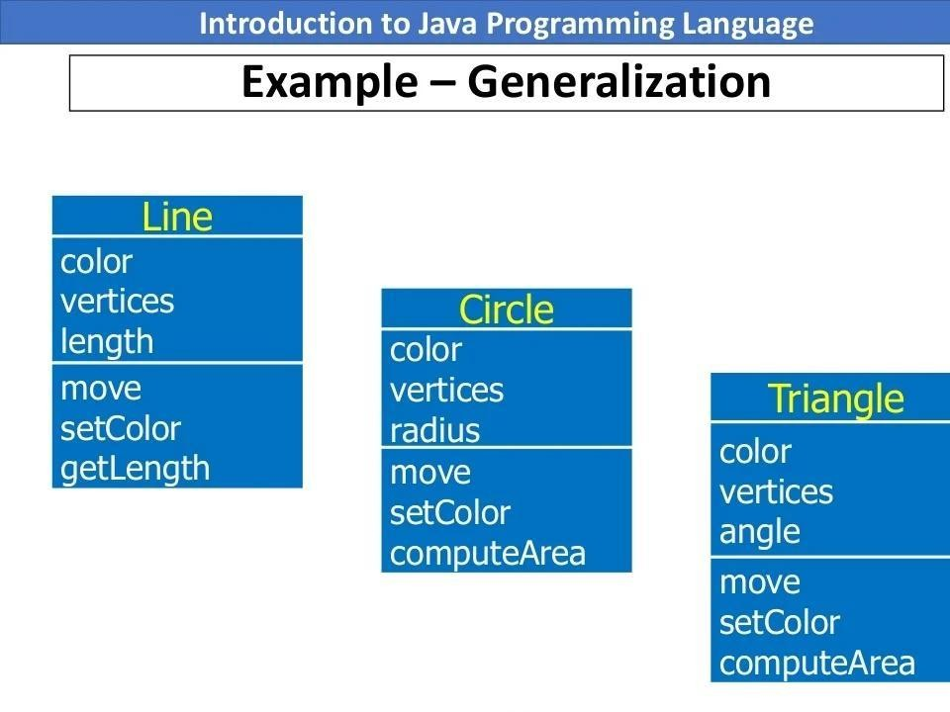

Slide 8
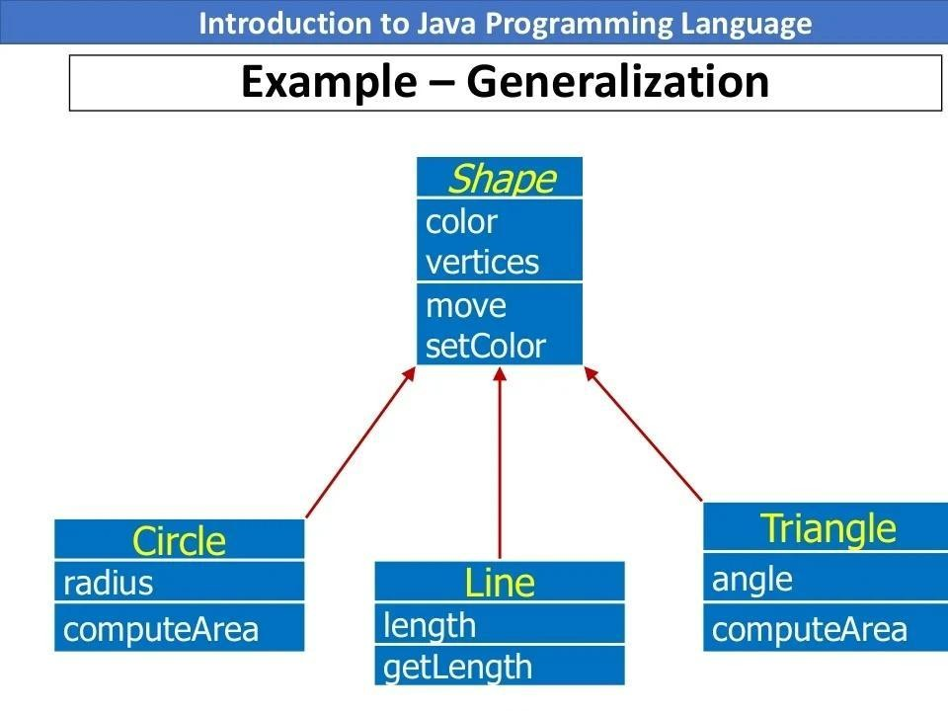

Slide 9
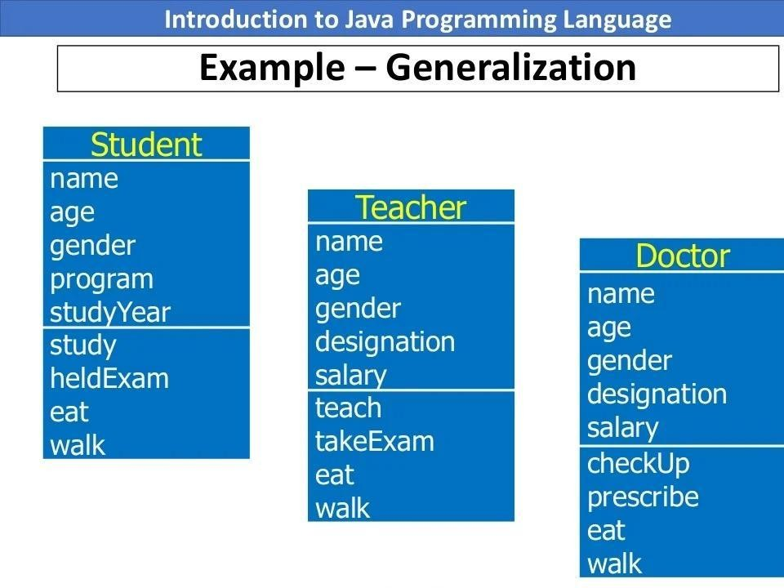

Slide 10
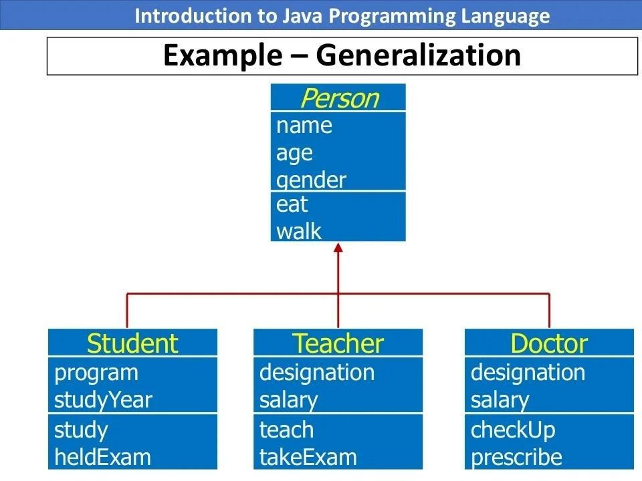

Slide 11
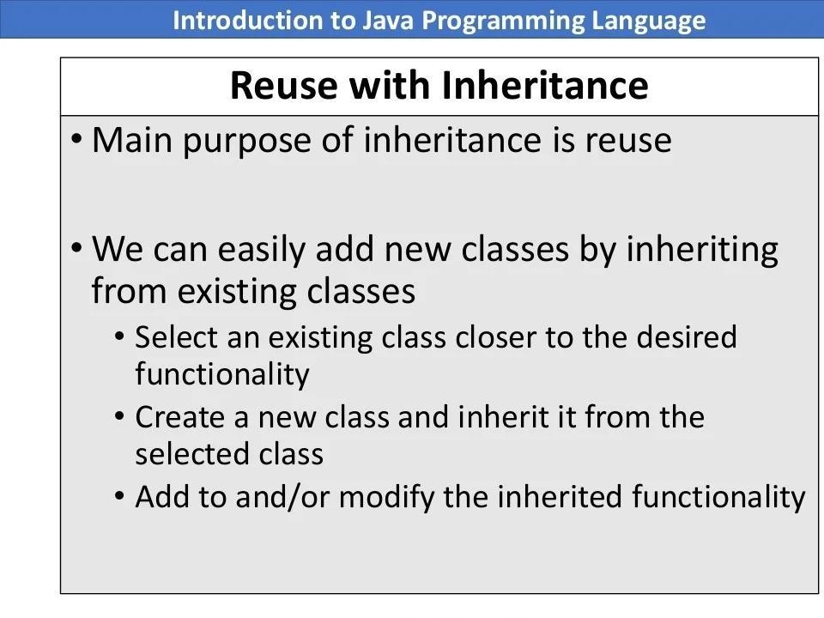

Slide 12
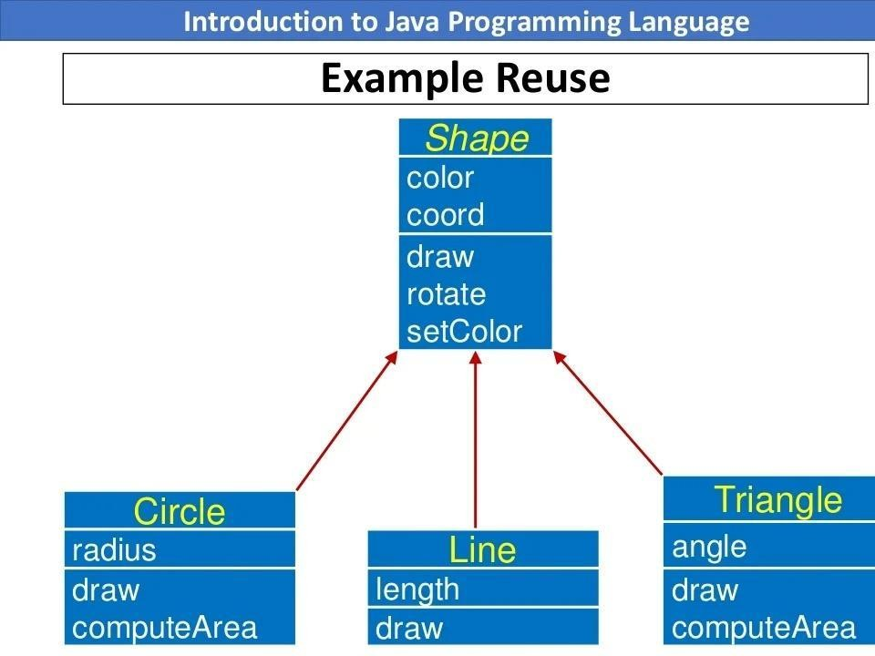

Slide 13
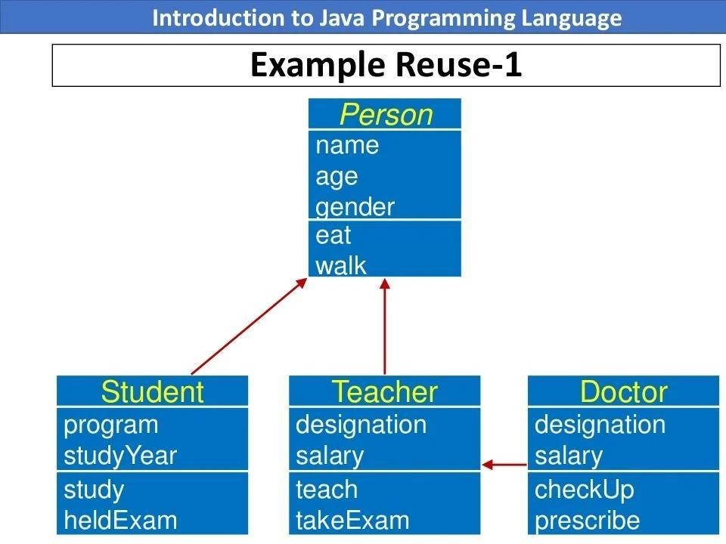

Slide 14


Slide 15
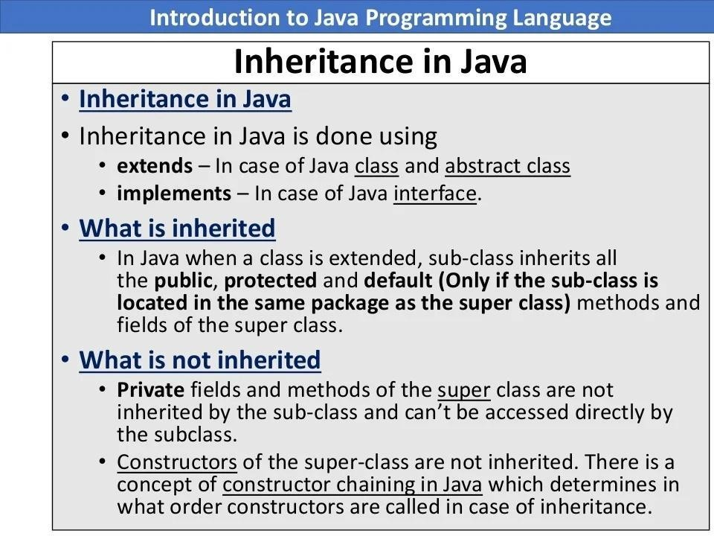

Slide 16
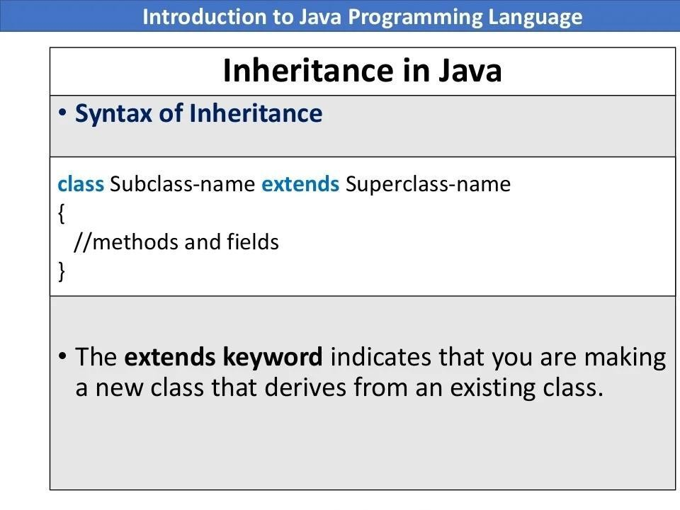

Slide 17
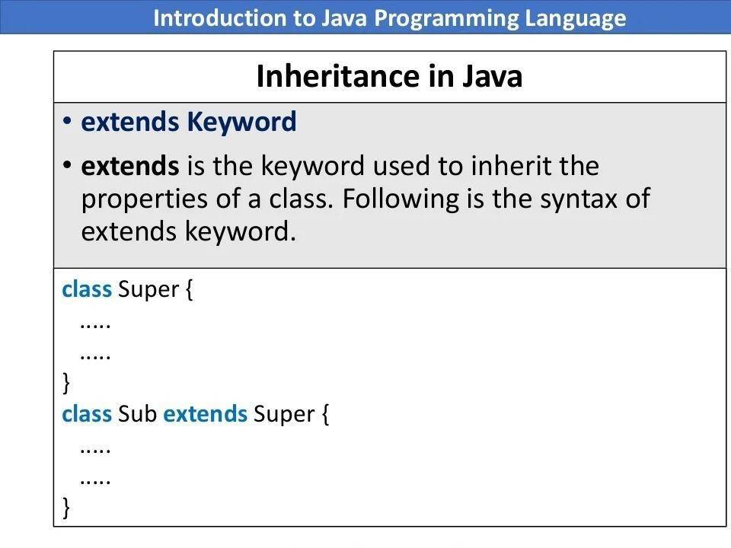

Slide 18
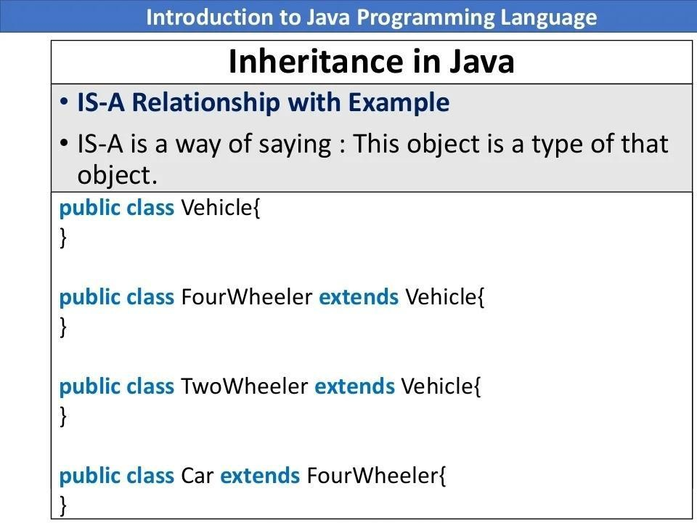

Slide 19
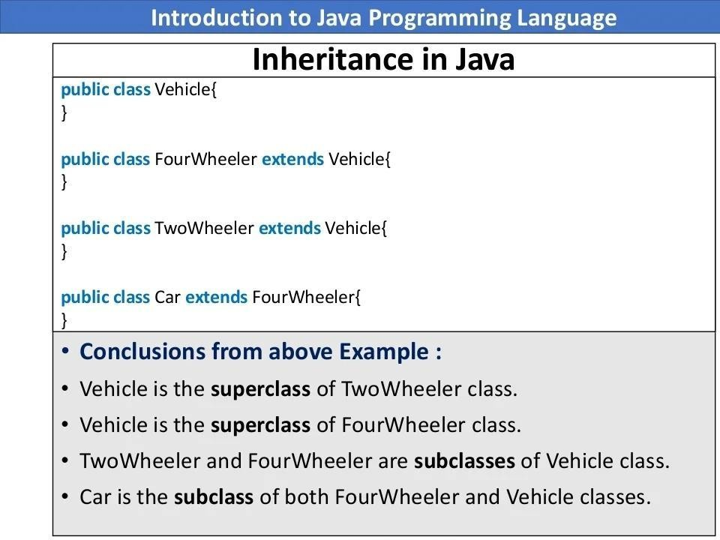

Slide 20
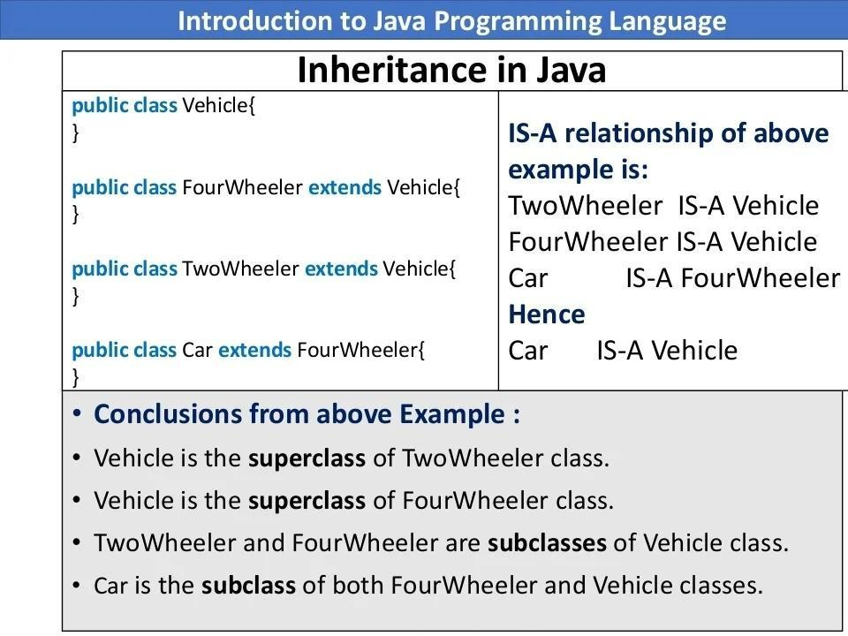

Slide 21
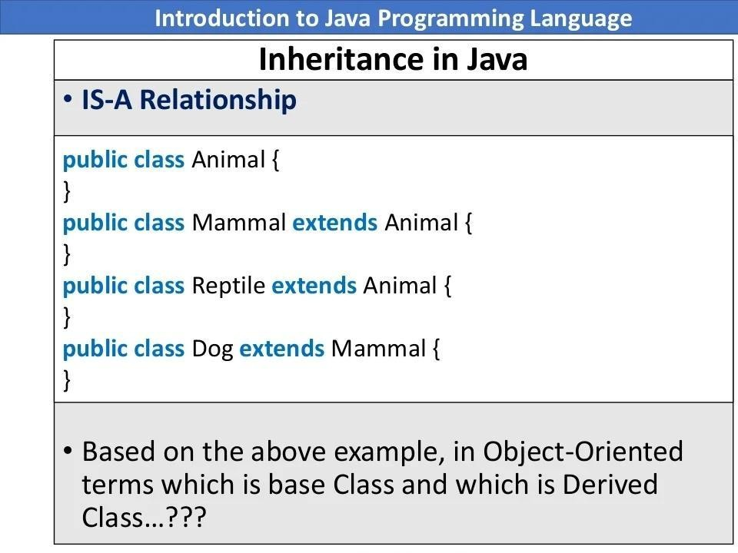

Slide 22
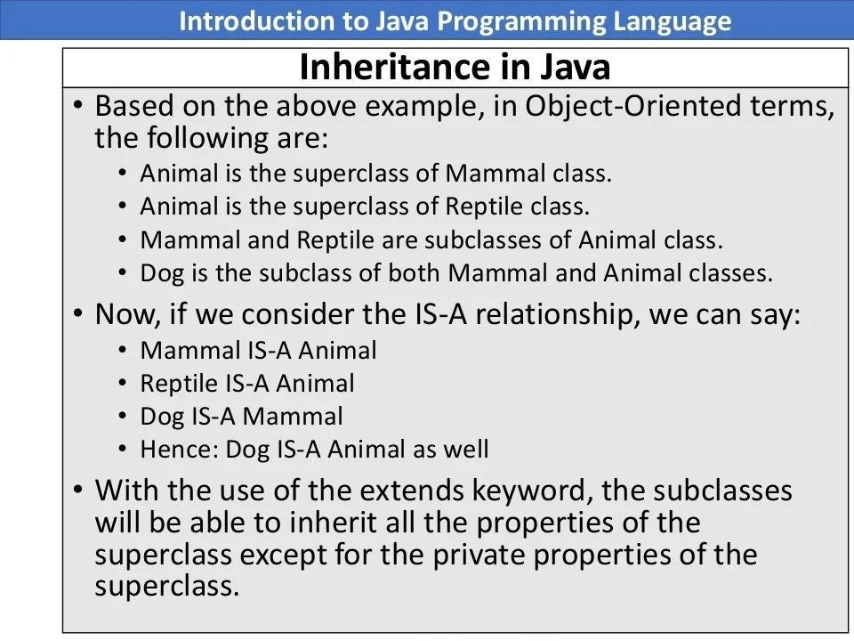

Slide 23
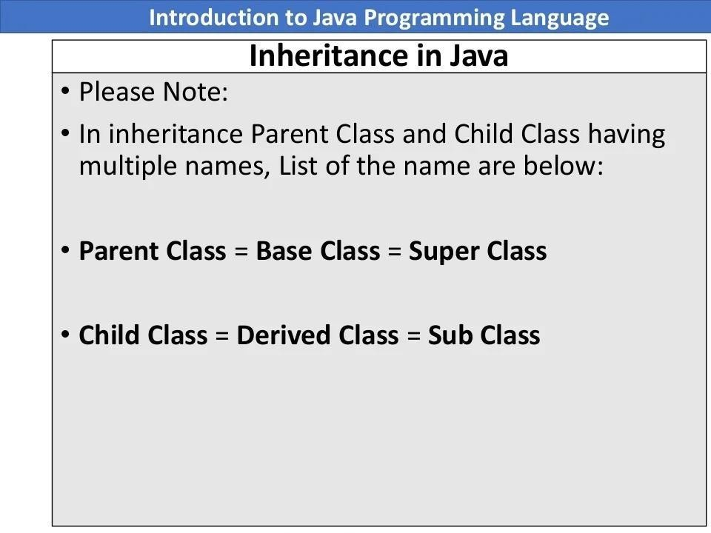

Slide 24
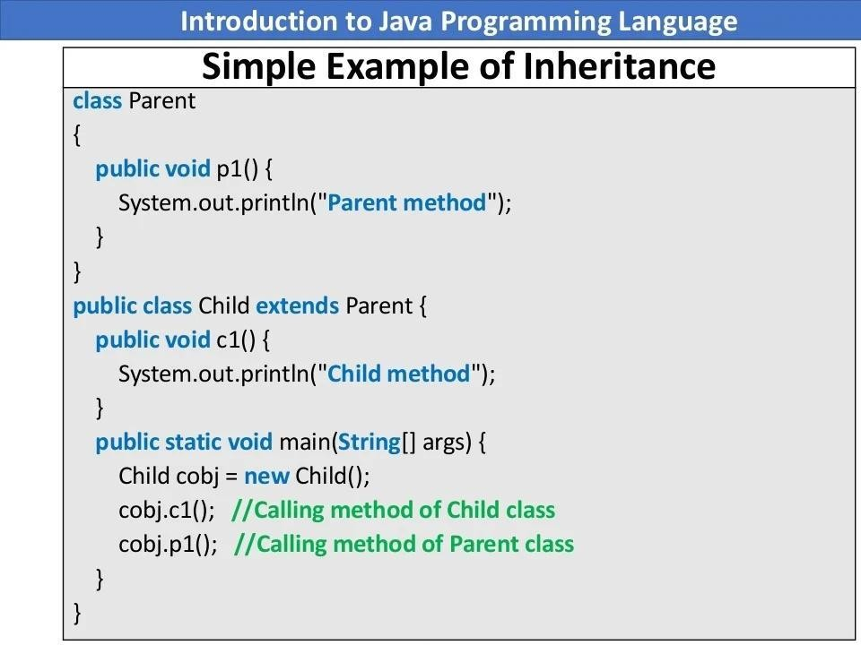

Slide 25
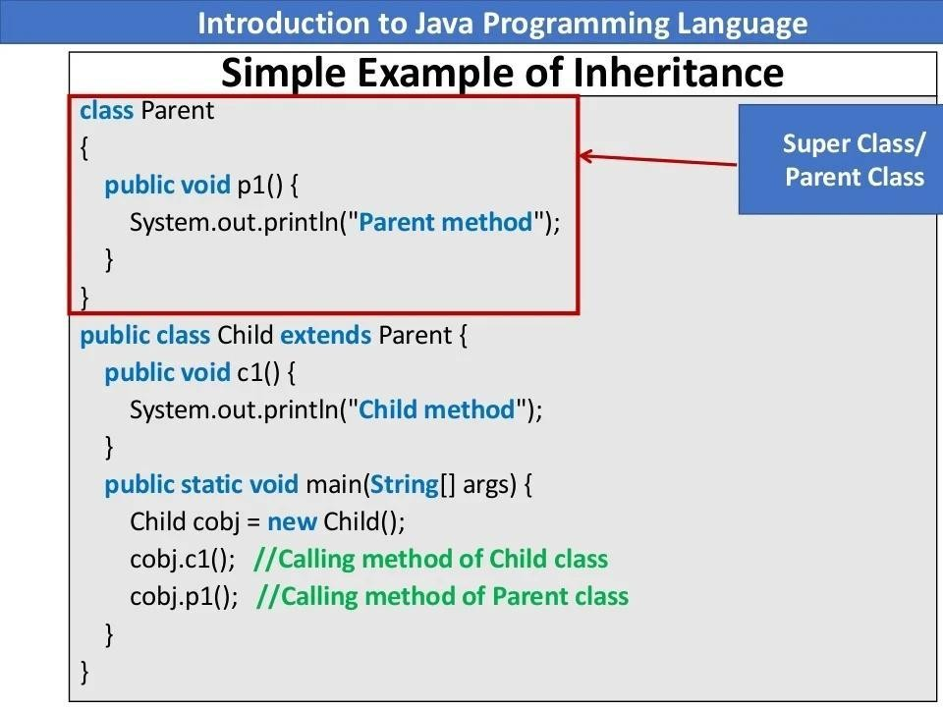

Slide 26
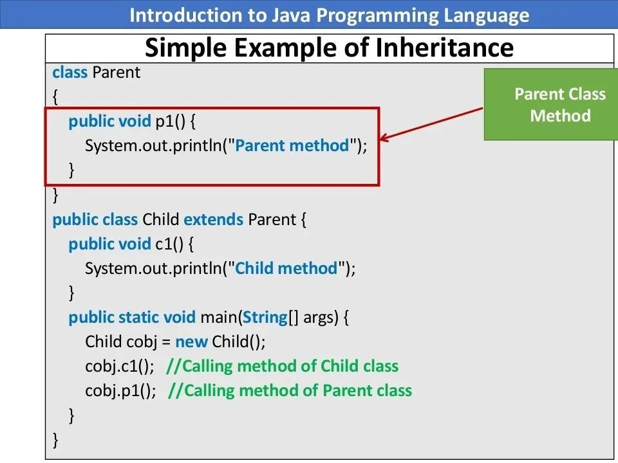

Slide 27
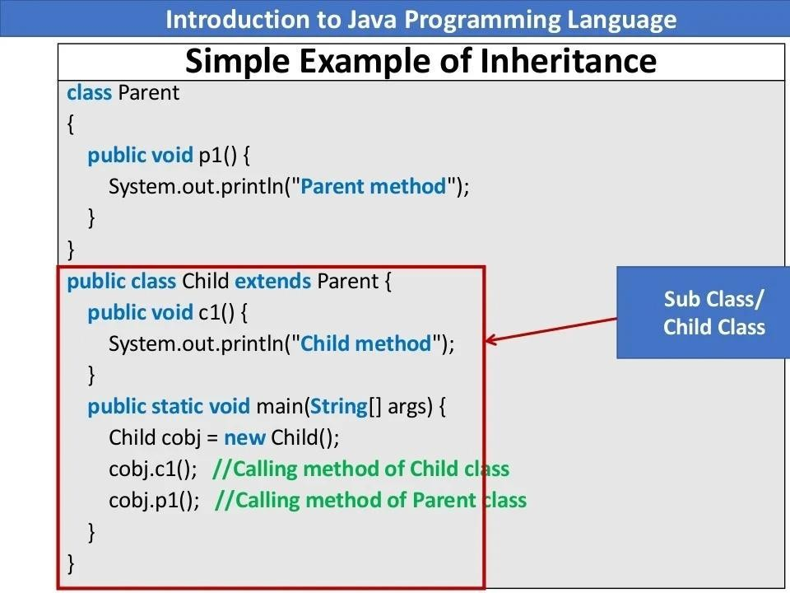

Slide 28
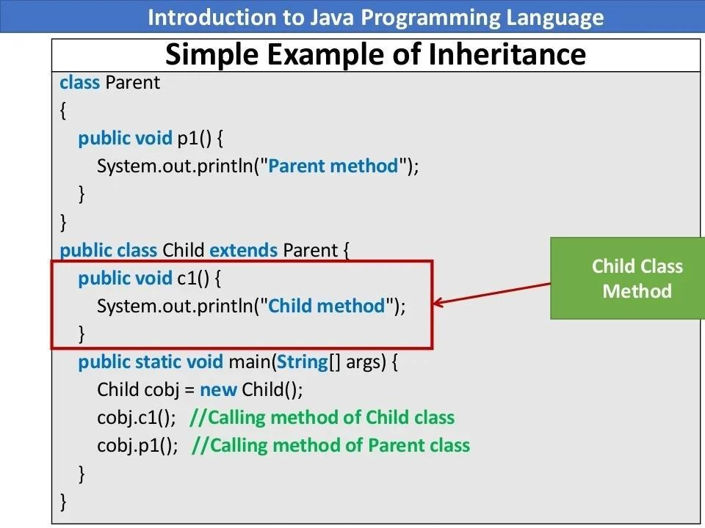

Slide 29
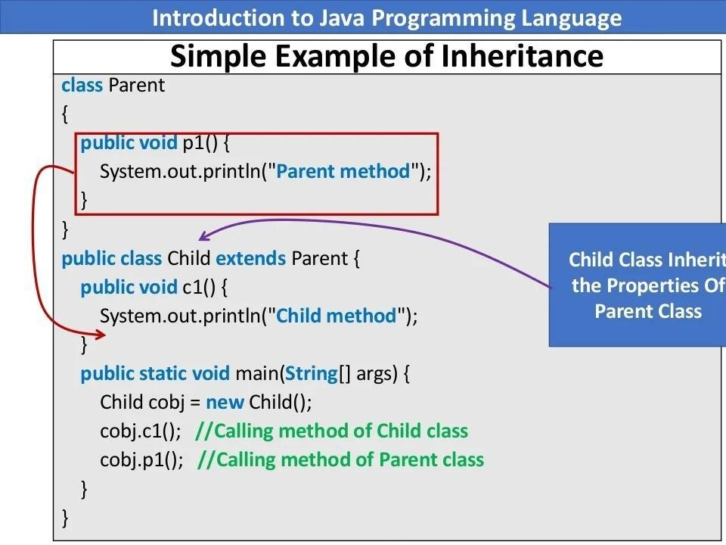
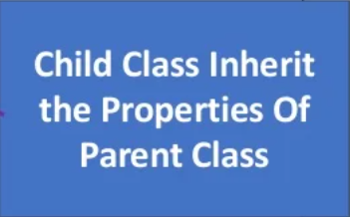

Slide 30
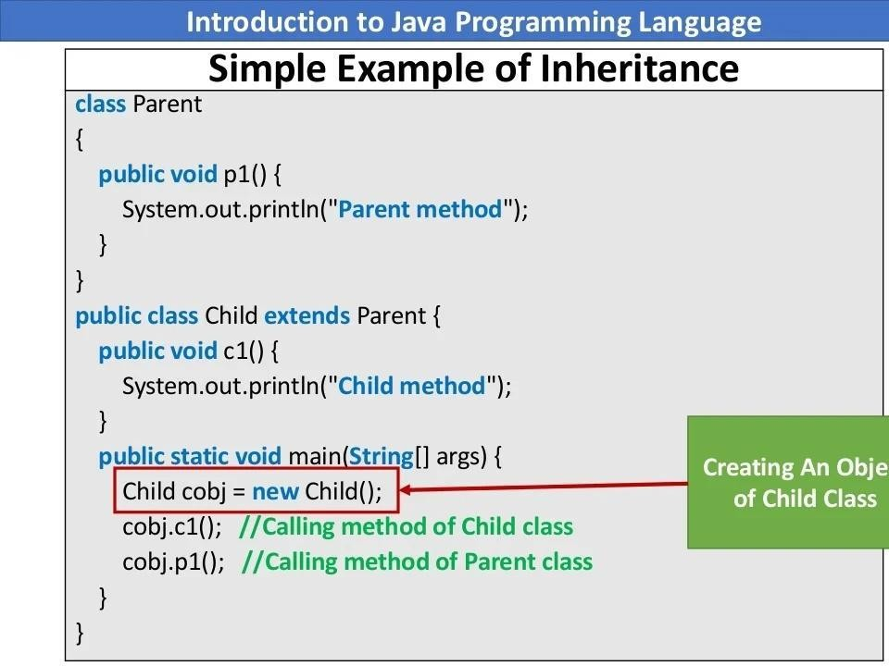
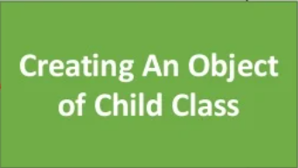

Slide 31
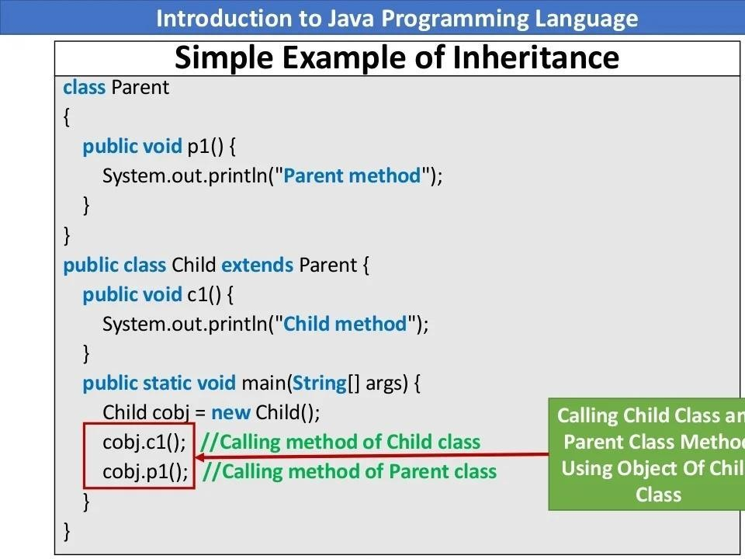
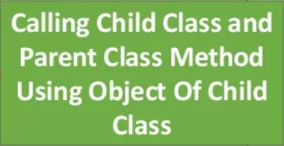

Slide 32
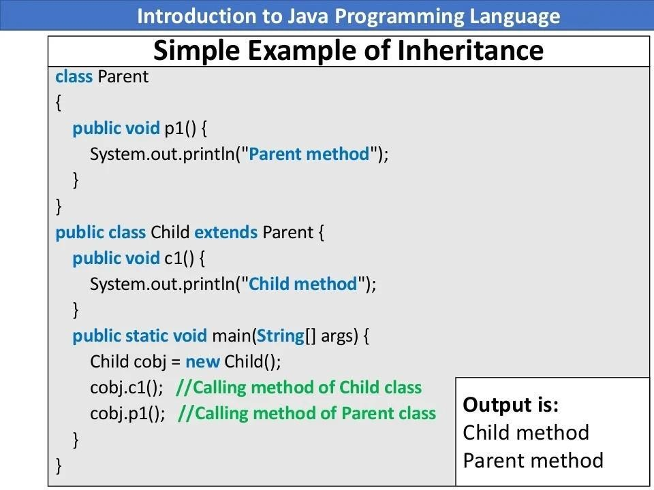

Slide 33
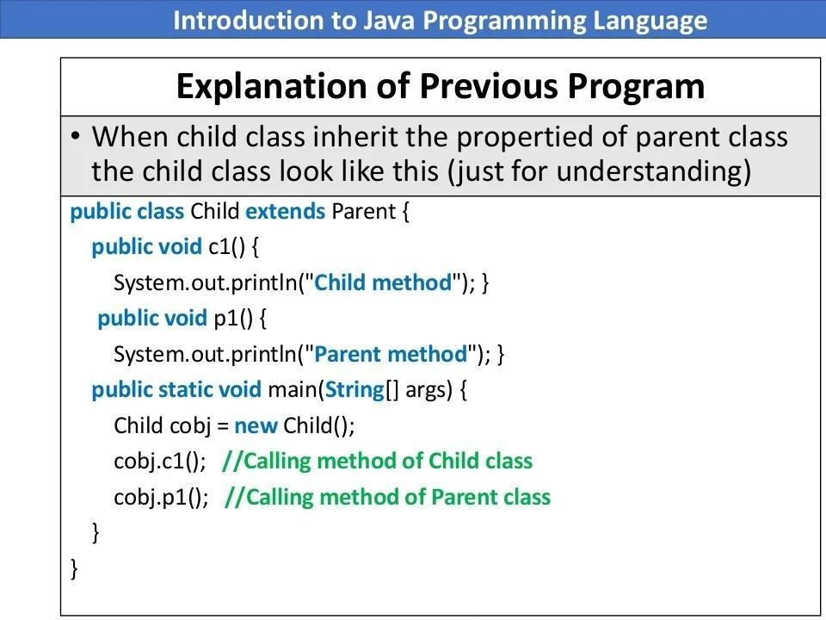

Slide 34
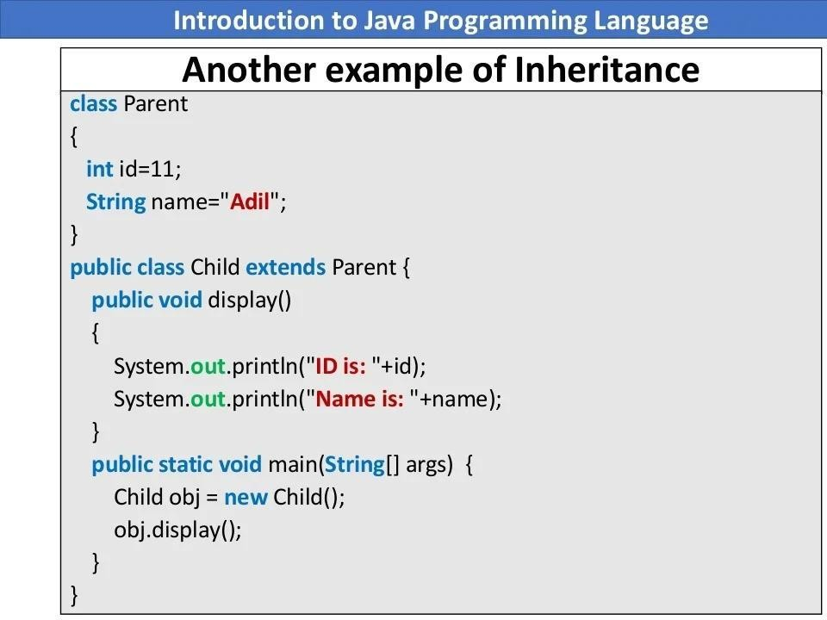

Slide 35
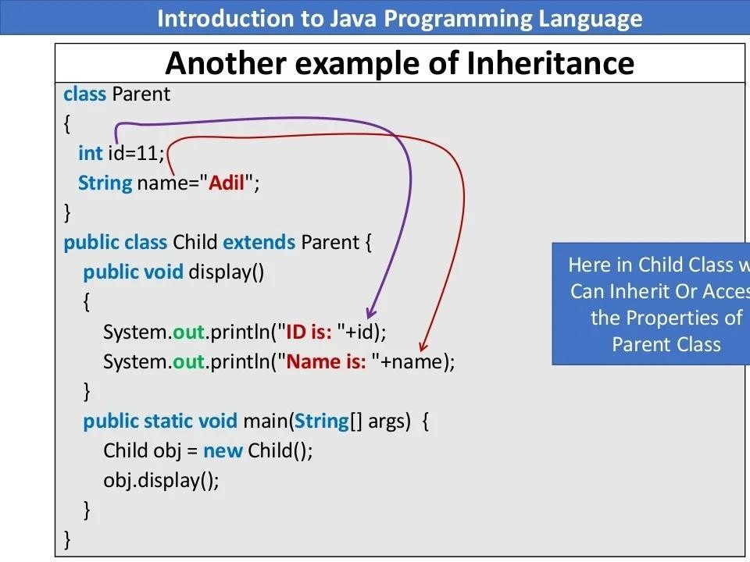
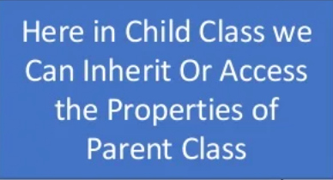

Slide 36
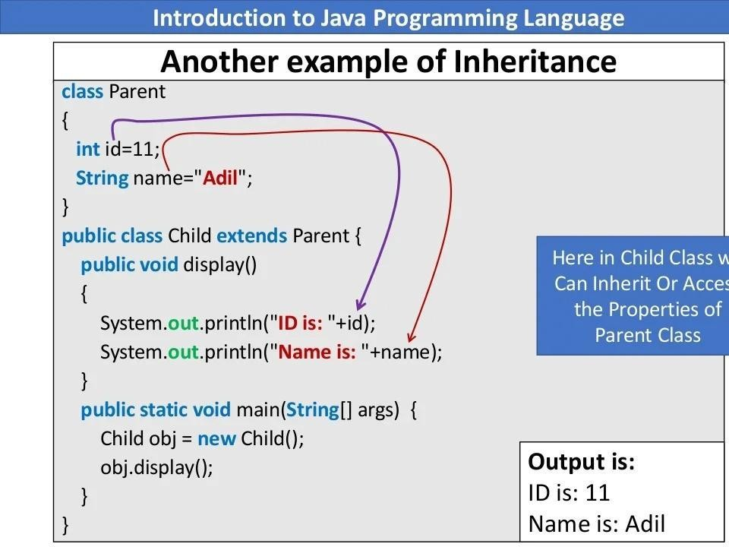

Slide 37
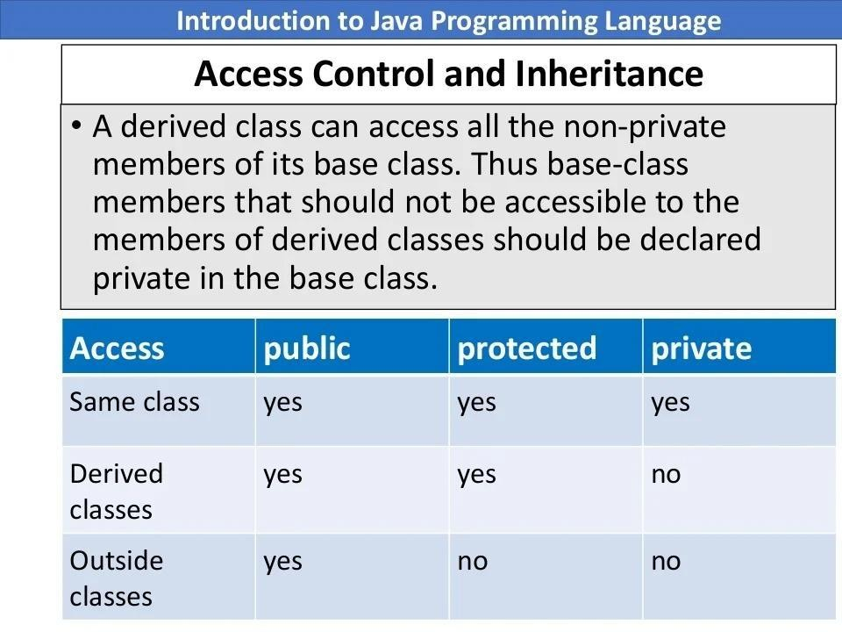

Slide 38
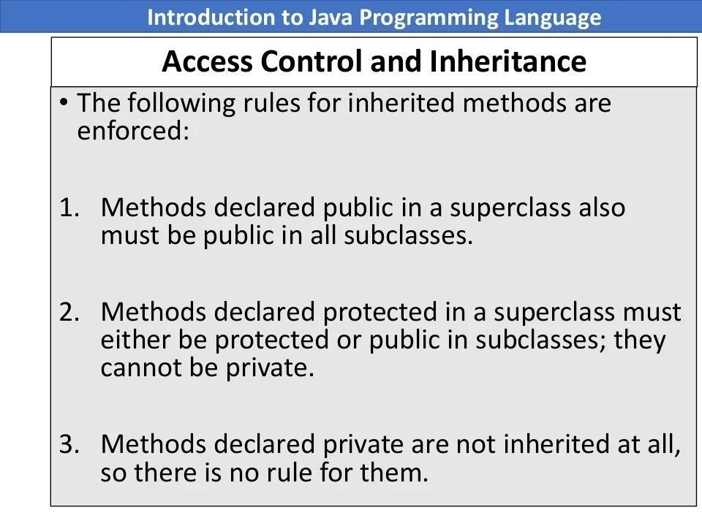

Slide 39
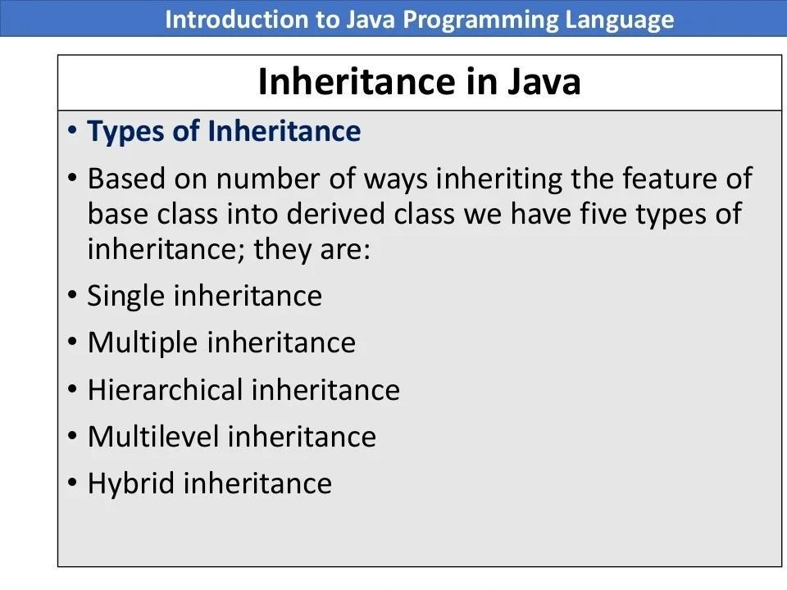

Slide 40
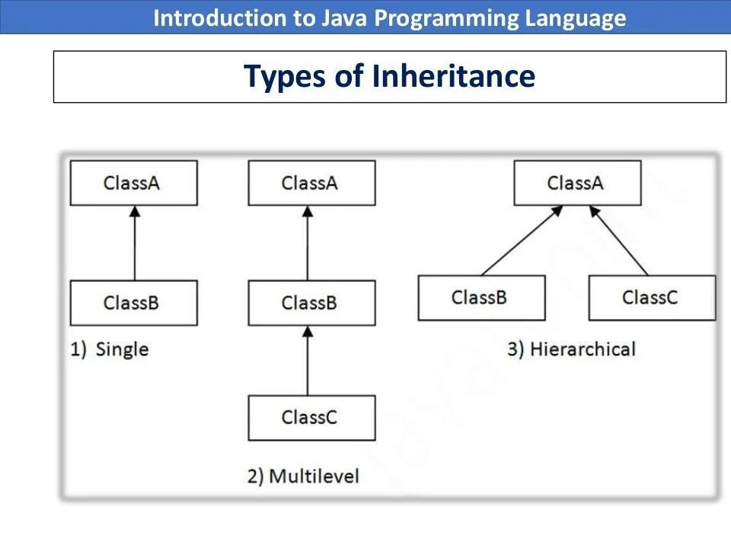

Slide 41
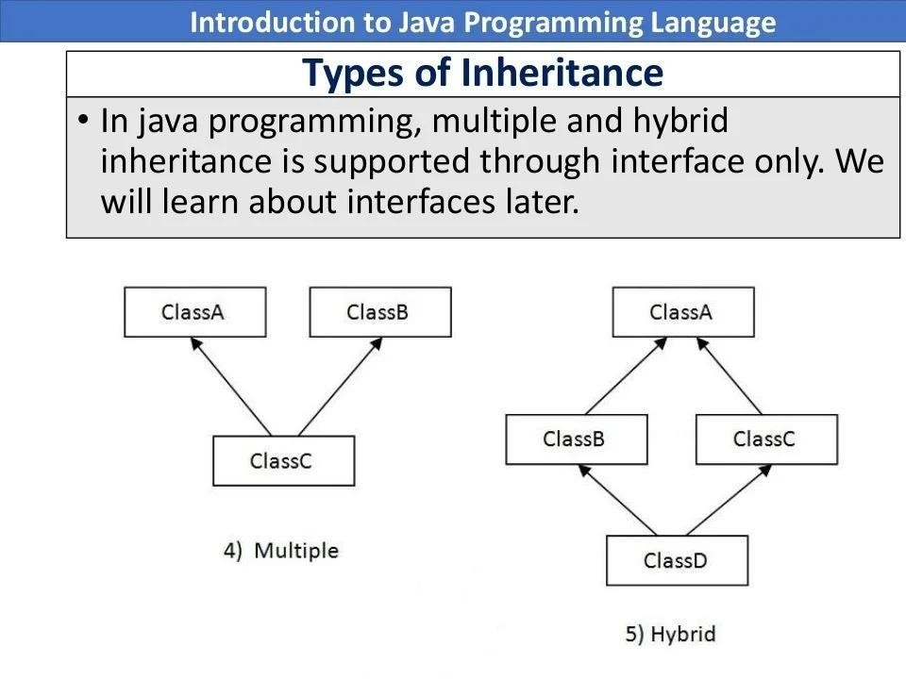

Slide 42
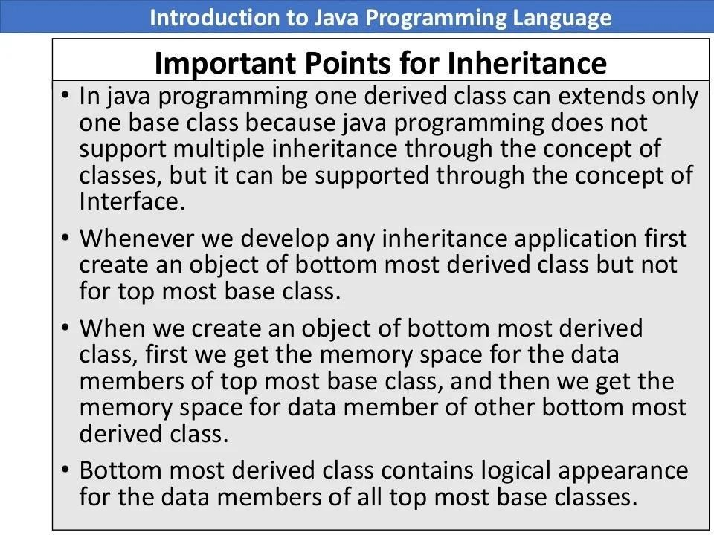

Slide 43
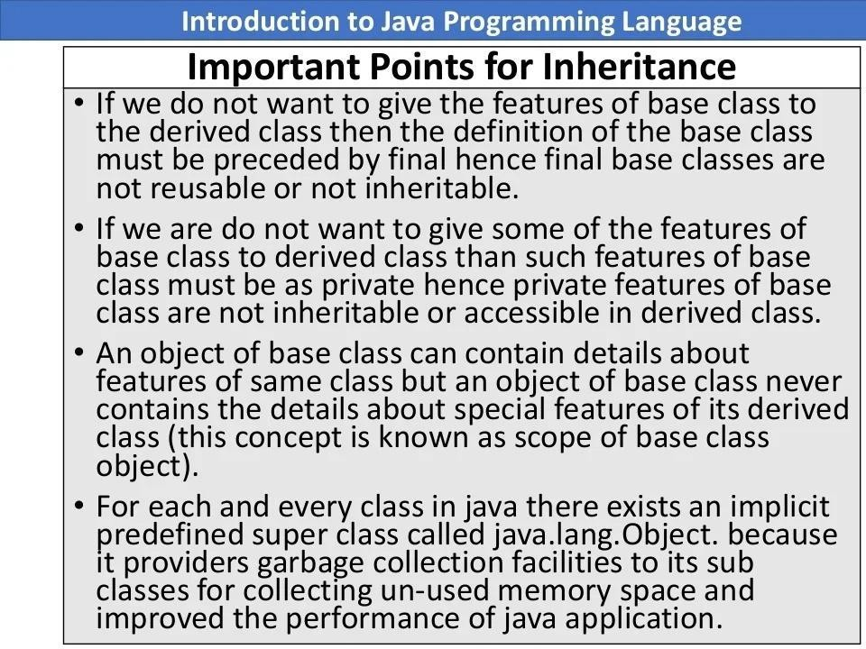

Slide 44
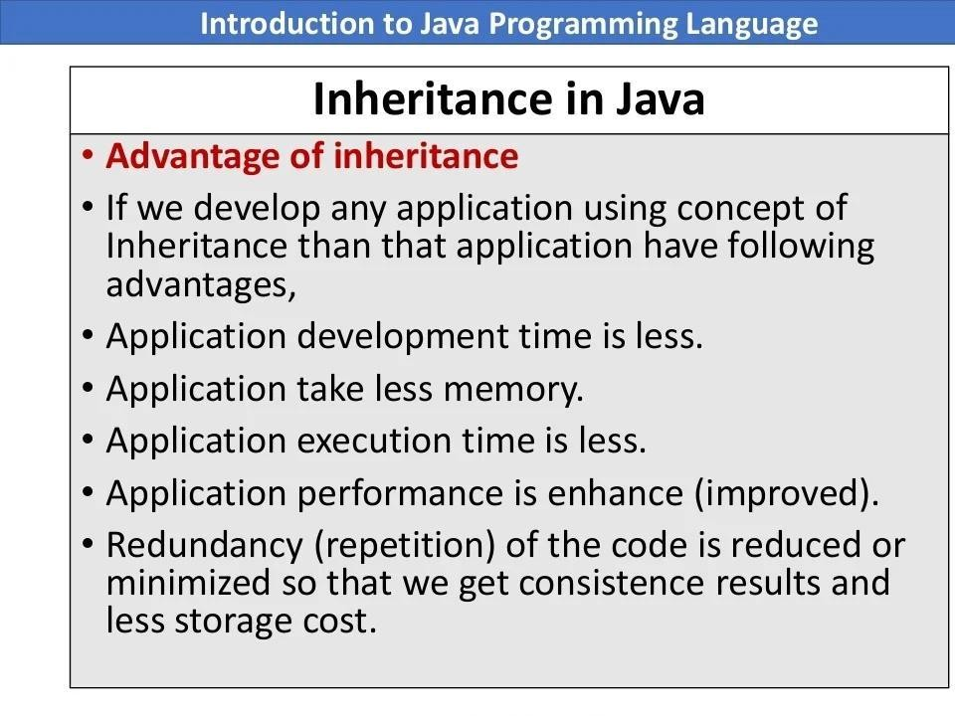

Slide 45
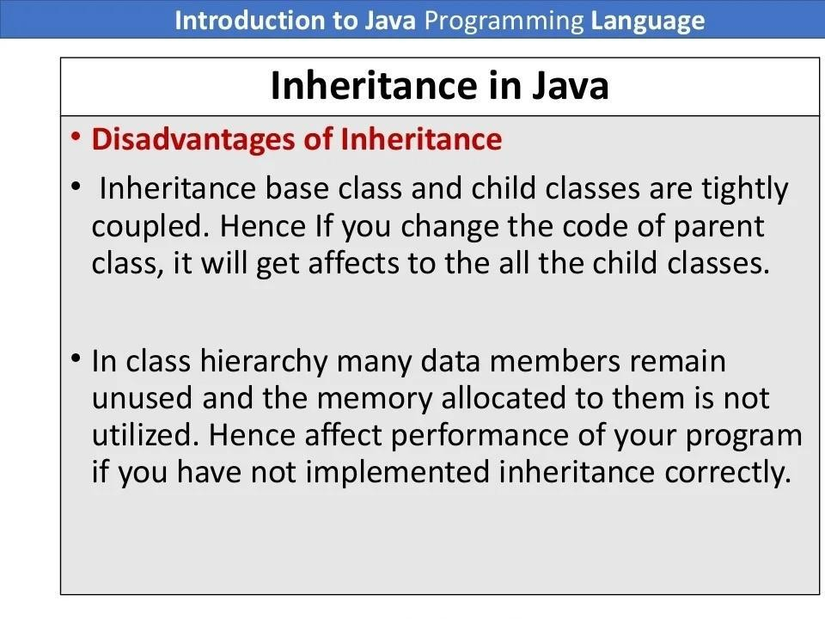

Slide 46
Polymorphism in Java

Slide 47
Polymorphism in Java
Polymorphism is an ability of object to behave in multiple forms
In Java polymorphism is mainly divided into two types:
Compile-time Polymorphism
Runtime Polymorphism
Compile-time polymorphism, also known as static polymorphism, is achieved by method overloading.
Runtime polymorphism is achieved by method overriding.
It is a process in which a function call to the overridden method is resolved at Runtime.

Slide 48
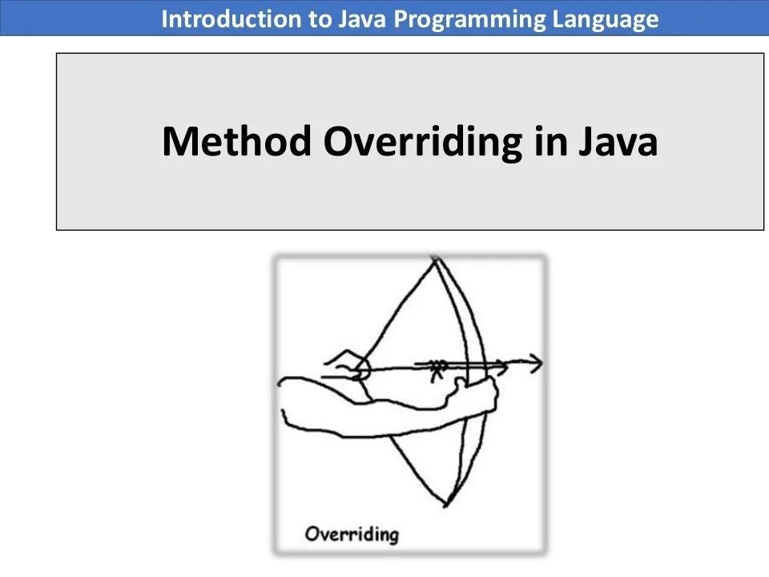

Slide 49
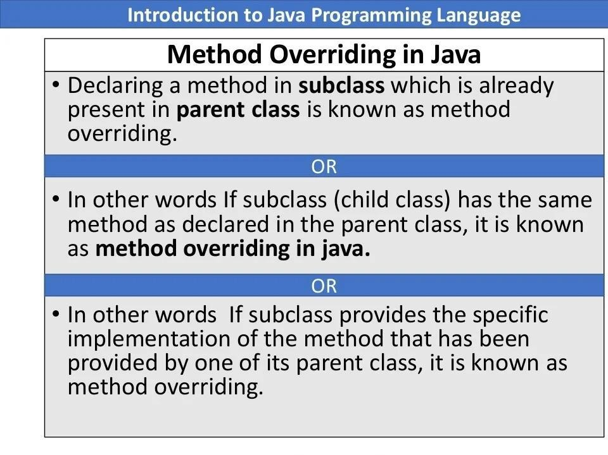

Slide 50
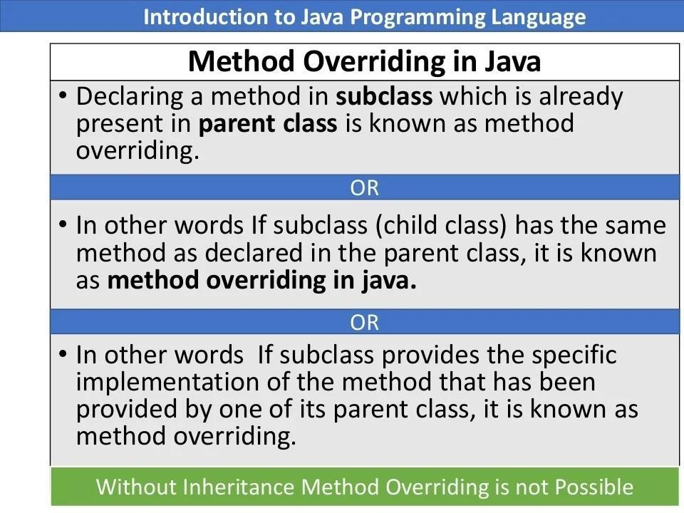

Slide 51


Slide 52


Slide 53


Slide 54


Slide 55


Slide 56


Slide 57


Slide 58


Slide 59


Slide 60


Slide 61


Slide 62


Slide 63


Slide 64


Slide 65


Slide 66


Slide 67


Slide 68


Slide 69


Slide 70


Slide 71


Slide 72


Slide 73


Slide 74


Slide 75


Slide 76


Slide 77


Slide 78


Slide 79
Exercises

Slide 80
Exercises
Create a class - 2DPoint.
Attributes - x and y coordinates as double data type.
Methods -
Constructor
IsEqualTo(2DPoint p2) - Checks if this point is the same as p2
Create a class - Line
Attributes -
ArrayList containing strictly two points. The two points can not be copies of each other. (How can you ensure these two rules?) Hint - use access modifiers and constructor.

Slide 81
Exercises
Methods -
Constructor - accepts two points
IsEqualTo(Line L2) - Checks if this line is the same as l2, i.e., is made up of the same two points.
length() - Returns the length of the line
Create a class Paralellogram-
Attributes:
ArrayList containing strictly four points. The four points can not be copies of one another. (How can you ensure these two rules?) Hint - use access modifiers and constructor.

Slide 82
Exercises
Methods -
Constructor - accepts four points
largestDiagonal() - Returns a line which is the largest diagonal of the parallelogram. Hint - The largest diagonal is larger than any side of a parallelogram. So finding the largest distance between all four points will do the trick.
perimeter()

Slide 83
Exercises
Class - Rectangle
Attributes -
ArrayList of four points
Methods -
Constructor,
largestDiagonal()
isValidRectangle()
perimeter()
area()

Slide 84
Exercises
Class - Square
Attributes -
ArrayList of four points
Methods -
Constructor,
largestDiagonal()
isValidRectangle()
isValidSquare()
perimeter()
area()
angleBetweenDiagonals() - For squares, it is always 90 degrees

Slide 85
Exercises
Don’t forget to use inheritance where necessary
All the best!

Slide 86
Exercise - 2
Consider the scenario -
Think about a library management system. Users are management staff, teachers, and students.
Teachers can write books and research papers, both of which are available in the library.
Students do not write books for this library. So they only write research papers.
For teachers, these are to be stored - Name, birth date, employee id, SSN, contact, department
For students, these are to be stored - Name, birth date, roll number, SSN, contact, department, year

Slide 87
Exercise - 2
Consider the scenario -
For books, these are to be stored - Title, description, author, genre, file URL (just a random string now)
For research papers, these are to be stored - Title, abstract, author, file URL (just a random string now)
Write a client program for teachers to -
Let them publish a book
Let them publish a research paper
Search a book by its title
Search a book by its author

Slide 88
Exercise - 2
Write a client program for teachers to (continued) -
Search a paper by its title
Search a paper by its author
The client program should allow students to -
Publish a research paper
Search a book by its title
Search a book by its author
Search a paper by its title
Search a paper by its author

Slide 89
Exercise - 2
The client program should allow management staff to -
Lend a book to a teacher or a student
Search teachers by their name or employee id
Search students by their roll number or name
Search a book by its title
Search a book by its author
Search a paper by its title
Search a paper by its author
See which books a teacher or a student has borrowed

Slide 90
Exercise - 2
To implement this, you can write a client program like this -
Press -
1 to login as staff
2 to login as teacher
3 to login as student

Slide 91
Exercise - 2
Then on inputting the appropriate number, the user sees the available functionalities for that type of users. Like so
Press -
1 to Publish a research paper
2 to Search a book by its title
3 to Search a book by its author
….
6 to go back to previous menu

Slide 92
Exercise - 2
The client program will only be concerned with handling the menu. Write it first. This will be easier.
All the other functionalities should be coded in the respective classes. The client program will only make the appropriate function calls.
Use inheritance and polymorphism as needed.
Good luck!

Slide 93


